Slide 1







PROPOSAL REPORT
Newsletter Agent
Presenter: Kimi
Report Date: July 27, 2025

Slide 2

01.
Project Overview
02.
Technical Architecture
03.
Core Functions
CONTENTS
04.
UI Demonstration
05.
Technical Highlights and Innovations
06.
Implementation Results
07.
Technical Challenges and Solutions
08.
Summary and Future Work

Slide 3
01
Project Overview

Slide 4


Project Background
The Problem of Information Overload
In today's digital era, information is growing explosively. People face an overwhelming volume of news daily, making it difficult to filter out valuable and relevant content. This results in low efficiency in information acquisition and the risk of missing important information. Therefore, there is an urgent need for an efficient and personalized news briefing generation tool to address this challenge.

Slide 5

Project Objective
To provide personalized news briefings
For different user groups—such as business decision-makers, academic researchers, and general information enthusiasts—generate accurate and high-quality personalized news summaries based on their specific needs and interests. This helps users quickly obtain key information, save time and effort, and enhance the value of information acquisition.

Slide 6
Technical Advantages
AI agents based on LangChain
Leveraging LangChain-driven AI agent technology, the system supports multi-step reasoning and task planning, dynamically invokes over eight specialized tools, and possesses robust dialogue history and context management capabilities. It also features adaptive decision-making and error-handling mechanisms, providing intelligent support for news briefing generation.

Slide 7
02
Technical Architecture

Slide 8
Architecture Design
1
2
3
4
Presentation Layer
Agent Layer
Tool Layer
Data Layer
Provides a clean and intuitive user interaction through a Gradio web interface, supporting real-time preview of generated news briefings to meet users' instant viewing needs.
The LangChain Agent serves as the core, responsible for multi-step reasoning and task decomposition. It coordinates the execution of various tools to ensure an efficient and orderly news briefing generation process.
Integrates data source tools and AI generation tools, covering multiple functions such as news data collection, content processing, and intelligent generation, providing robust tool support for the system.
Integrates multiple data sources such as NewsAPI, Reddit, and RSS feeds. The collected data undergoes processing modules including categorization, deduplication, and quality
assessment, providing rich and high-quality raw data for news briefing generation.

Slide 9
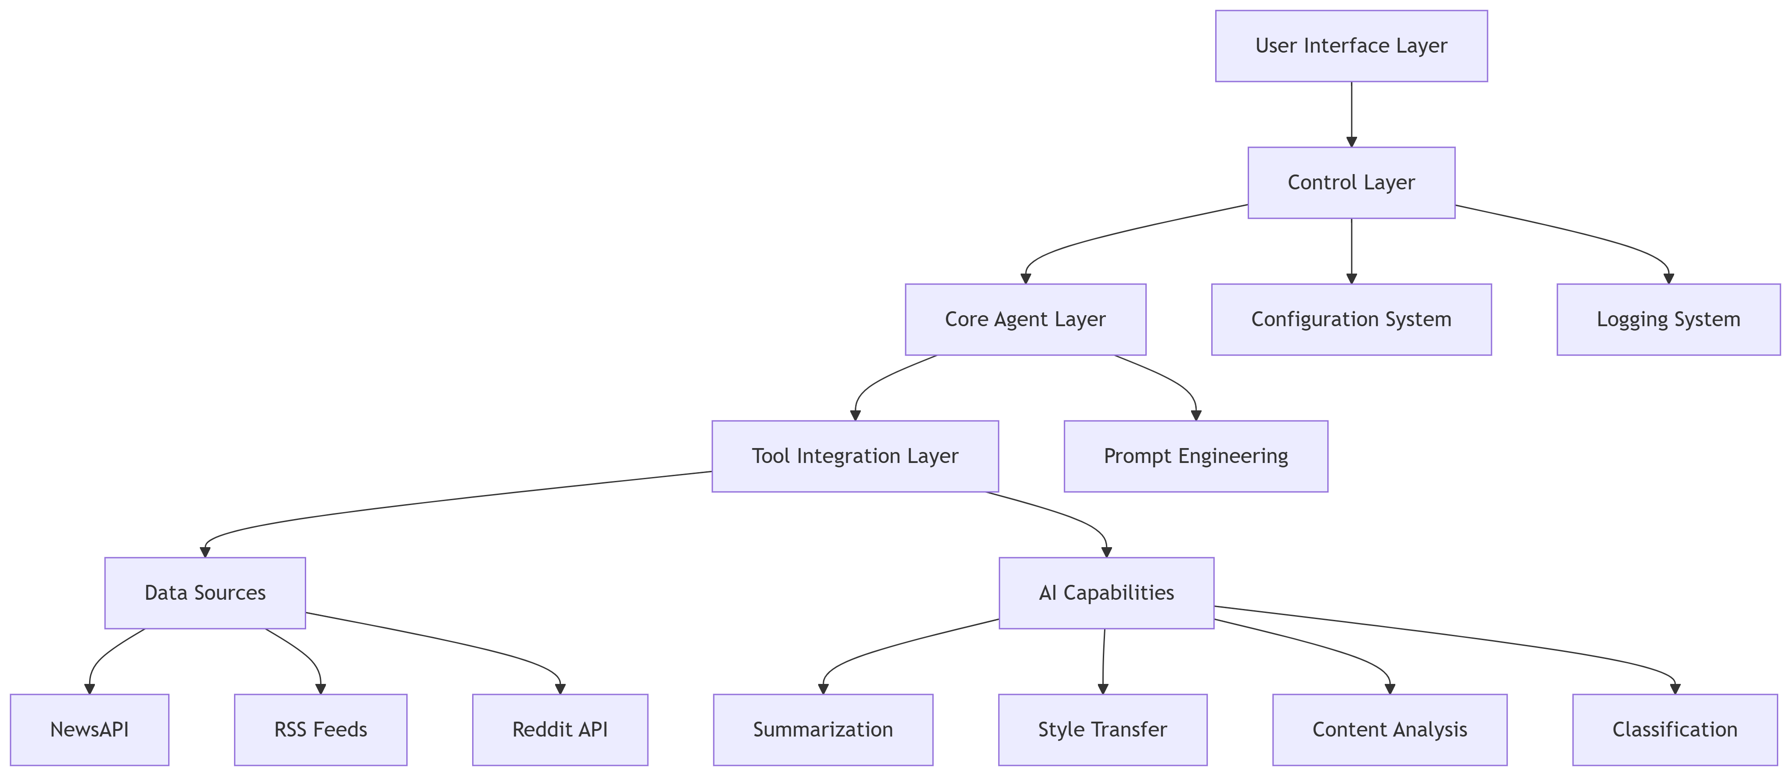
Architecture Design

Slide 10


Core Technology Stack
AI Framework
User Interface
Utilizes LangChain and OpenAI API as the AI framework. Leveraging their powerful language models and reasoning capabilities, the system achieves intelligent content generation and multi-step task reasoning, providing the core driving force for news briefing generation.
The user interface is built with Gradio, combining dual-format output in HTML and Markdown. This provides users with flexible and diverse viewing options to meet reading needs across different scenarios.
Data Sources
Content Processing
In terms of data sources, the system integrates NewsAPI to obtain real-time data from over 80,000 news outlets, utilizes the Reddit API to mine community discussions and trending topics, and supports various RSS feed parsing. This diverse data sourcing enriches the content and meets the requirements of different news categories.
In terms of content processing, TF-IDF keyword extraction and machine learning classification techniques are employed to intelligently categorize, deduplicate, and assess the quality of news data, ensuring the generated news briefings are accurate and high-quality.

Slide 11
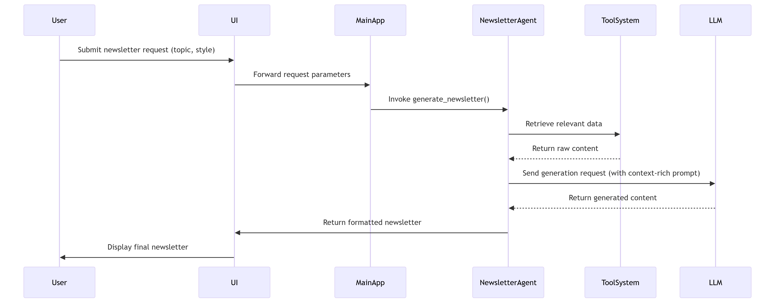
Core Workflow

Slide 12
03
Core Functions

Slide 13
AI Agent Capabilities
Multi-Step Task Reasoning
Dialogue History Management
The AI agent can automatically decompose complex tasks into multiple subtasks and perform sequential reasoning and execution. For example, it first collects news from multiple data sources, then integrates and assesses the quality of the content, and finally generates the briefing, ensuring efficient task completion.
Stores the conversation history between users and the system to understand contextual information, enabling continuous dialogue and task correlation, thereby providing users with a more coherent and personalized service experience.
Dynamic Tool Invocation
Adaptive Decision-Making
Dynamically invokes over eight specialized tools based on task requirements, such as data collection tools, content generation tools, and quality assessment tools. This flexible combination of tool functionalities meets the diverse needs of various news briefing generation scenarios.
The AI agent possesses adaptive decision-making capabilities, allowing it to automatically adjust task strategies and the sequence of tool invocation based on task progress and feedback, ensuring smooth task execution and improving the quality of generated results.

Slide 14
Multi-Source Data Integration
Multi-Source Data Access
Content Classification
Implemented integration with multiple data sources including NewsAPI, Reddit API, and RSS feeds, covering a wide range of news domains and trending topics, providing rich material for news briefing generation.
Utilizes machine learning techniques to intelligently classify news into over 10 categories, including technology, business, health, and more. This facilitates users to browse content as needed and improves information acquisition efficiency.
Intelligent Deduplication
Quality Assessment
Employs intelligent algorithms to remove duplicates from multi-source data, preventing repetitive news interference and ensuring the news briefings are concise and unique.
Evaluates the quality of the collected news content to filter out high-quality and valuable information, enhancing the overall quality of news briefings and providing users with reliable information.

Slide 15
Personalized Content Generation
Multiple Writing Styles
Target Audience Customization
Supports various writing styles including professional, casual, academic, and creative. Users can select styles according to their needs and preferences, catering to diverse reading scenarios.
Generates news briefings tailored to different target audiences such as general users, technical professionals, business leaders, and academics, aligning with their professional backgrounds and interests to enhance information relevance and practicality.
Adjustable Length
Category Filtering
Offers three length options—short, medium, and long—allowing users to flexibly choose the news briefing length based on their time availability and information needs, enabling personalized customization.
Users can filter news by over 10 categories such as technology, business, health, and more, enabling precise access to news in areas of interest, avoiding information overload, and enhancing user experience.

Slide 16
04
UI Demonstration

Slide 17



UI Design
Main Interface Layout
User Guide
System Status Display
Result Preview
The main interface is clean and intuitive, providing clear parameter setting options. Users can easily configure various news briefing generation parameters such as data source selection, writing style, and content length, enabling convenient operation.
Provides comprehensive feature descriptions and step-by-step operation instructions to help users get started quickly. Even first-time users can easily master the system’s functionalities, reducing the learning curve.
Provides real-time updates on the AI agent and data source statuses, enabling users to monitor system operations at any time, such as data collection progress and task execution status, thereby enhancing system transparency.
Supports dual-format preview in HTML and Markdown, allowing users to instantly view the generated news briefing and adjust parameters in real time to ensure the final output meets expectations.

Slide 18
User Experience Highlights
One-Click Generation
Status Transparency
After users set their parameters, the news briefing generation process can be initiated with a single click. The system automatically completes the task and provides real-time progress feedback, enhancing operational efficiency.
The system status is displayed in real time, giving users a clear understanding of the news briefing generation process and enhancing their trust in the system.
Dual-Format Output
Comprehensive Guidance
Provides output in both HTML and Markdown formats to meet users’ needs in different scenarios, such as web viewing or document editing, enhancing flexibility.
Provides complete usage instructions to help users quickly familiarize themselves with the system’s features, reduce operational errors, and improve the overall user experience.

Slide 19
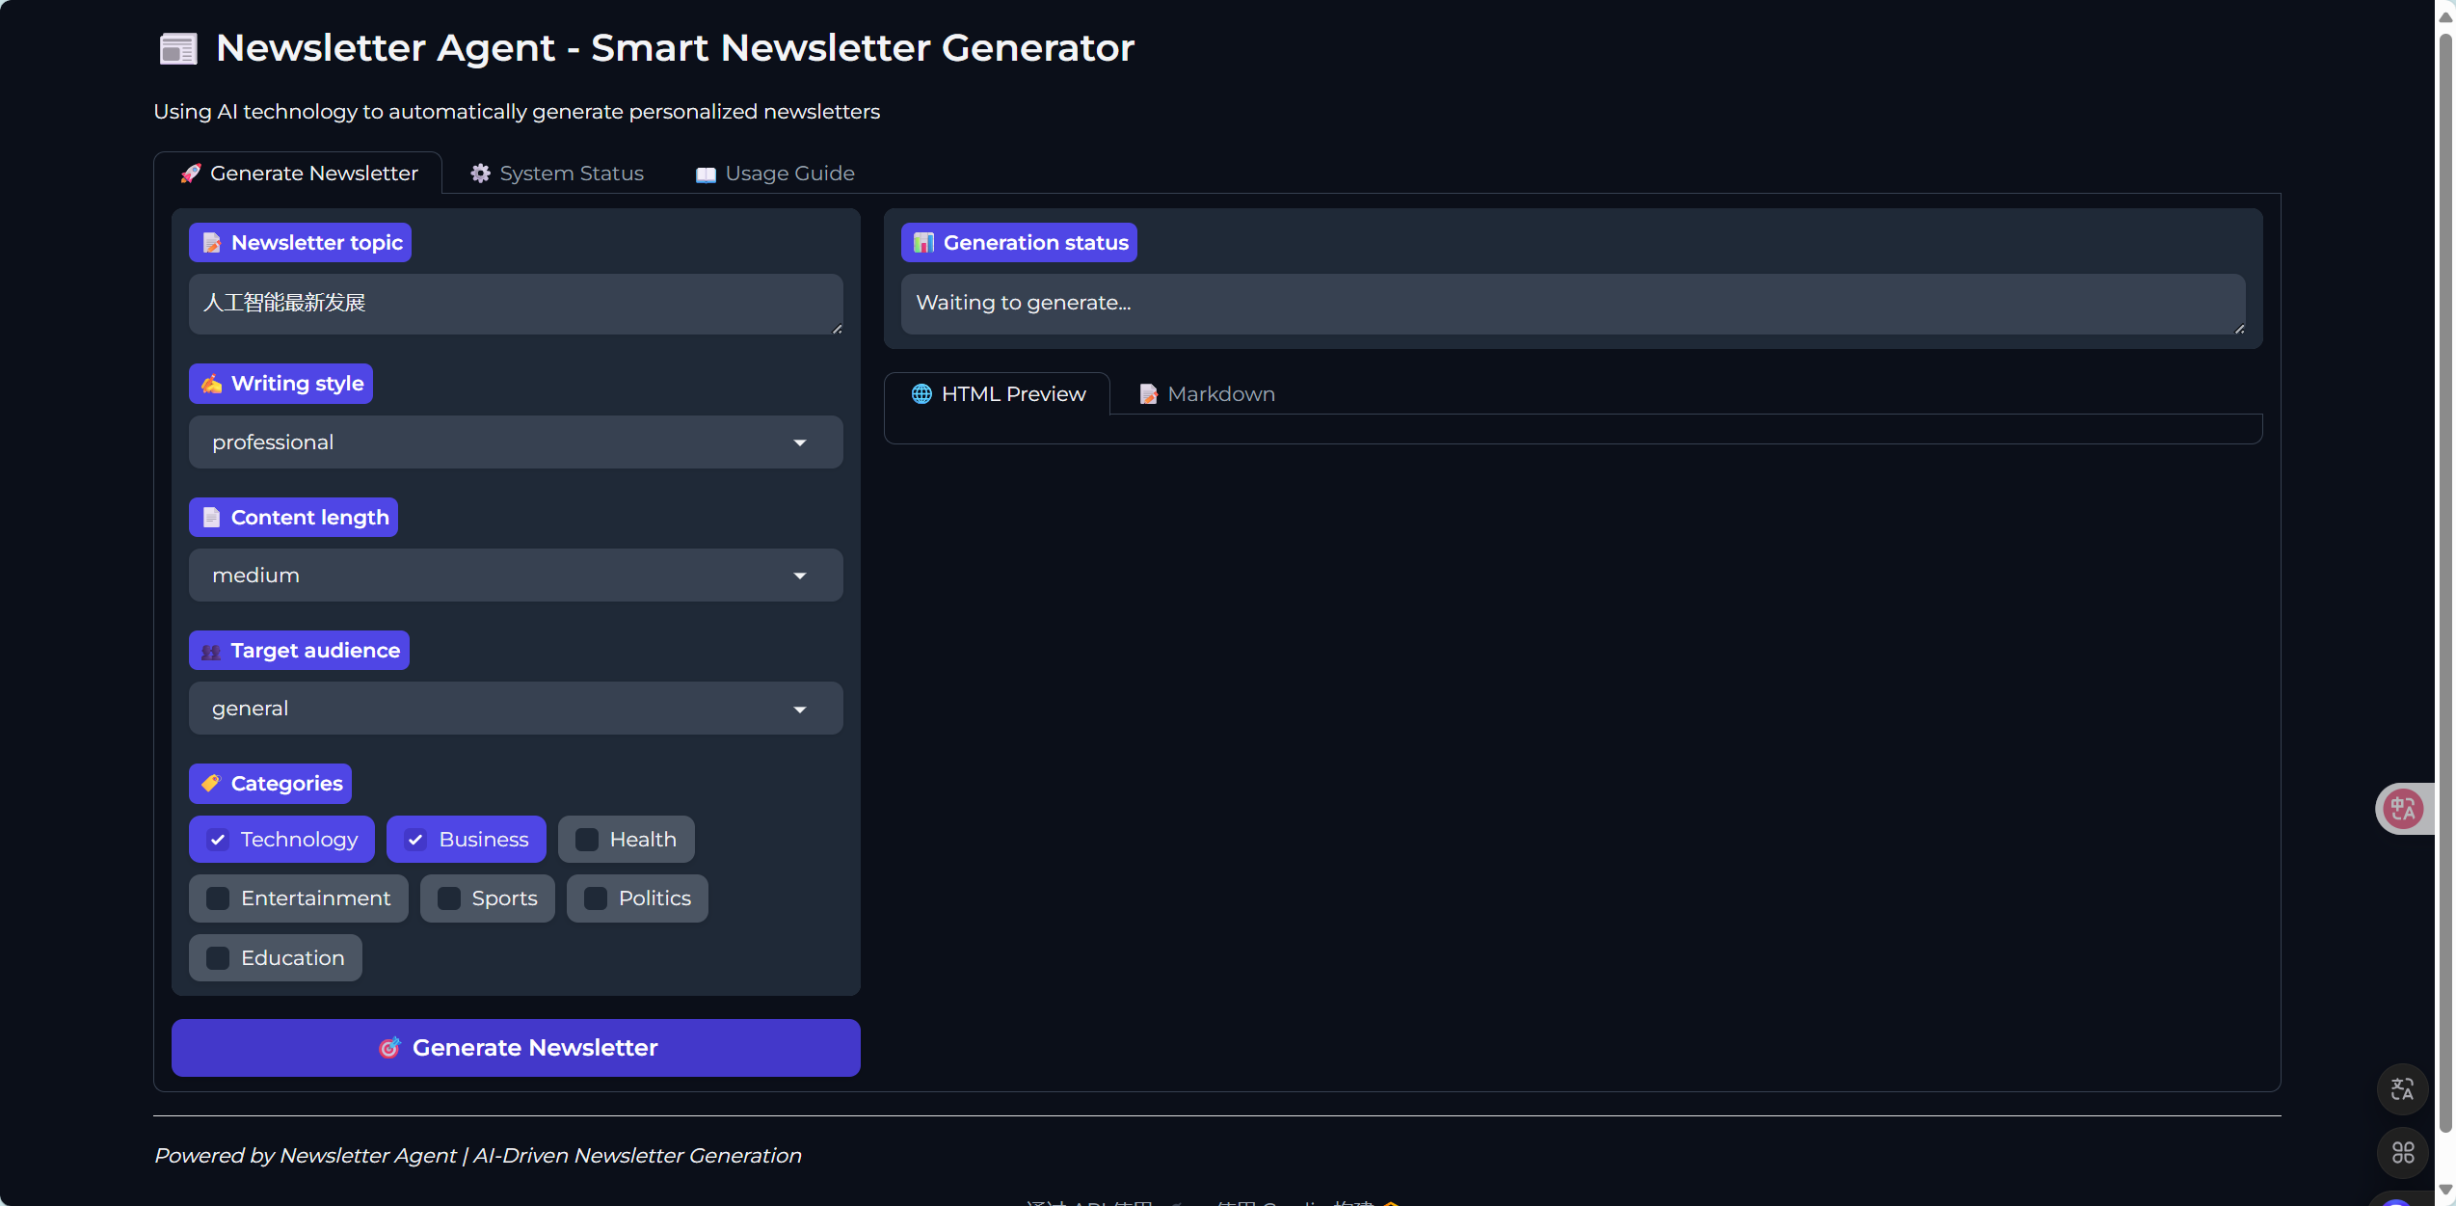

Newsletter agent –Smart Newsletter Generator
The topic you want to learn
The style: amateur, professional
Content length you want：short，medium，Long
People who read it : general，professor，et al
Let‘s have a try !
Domains you are interested

Slide 20
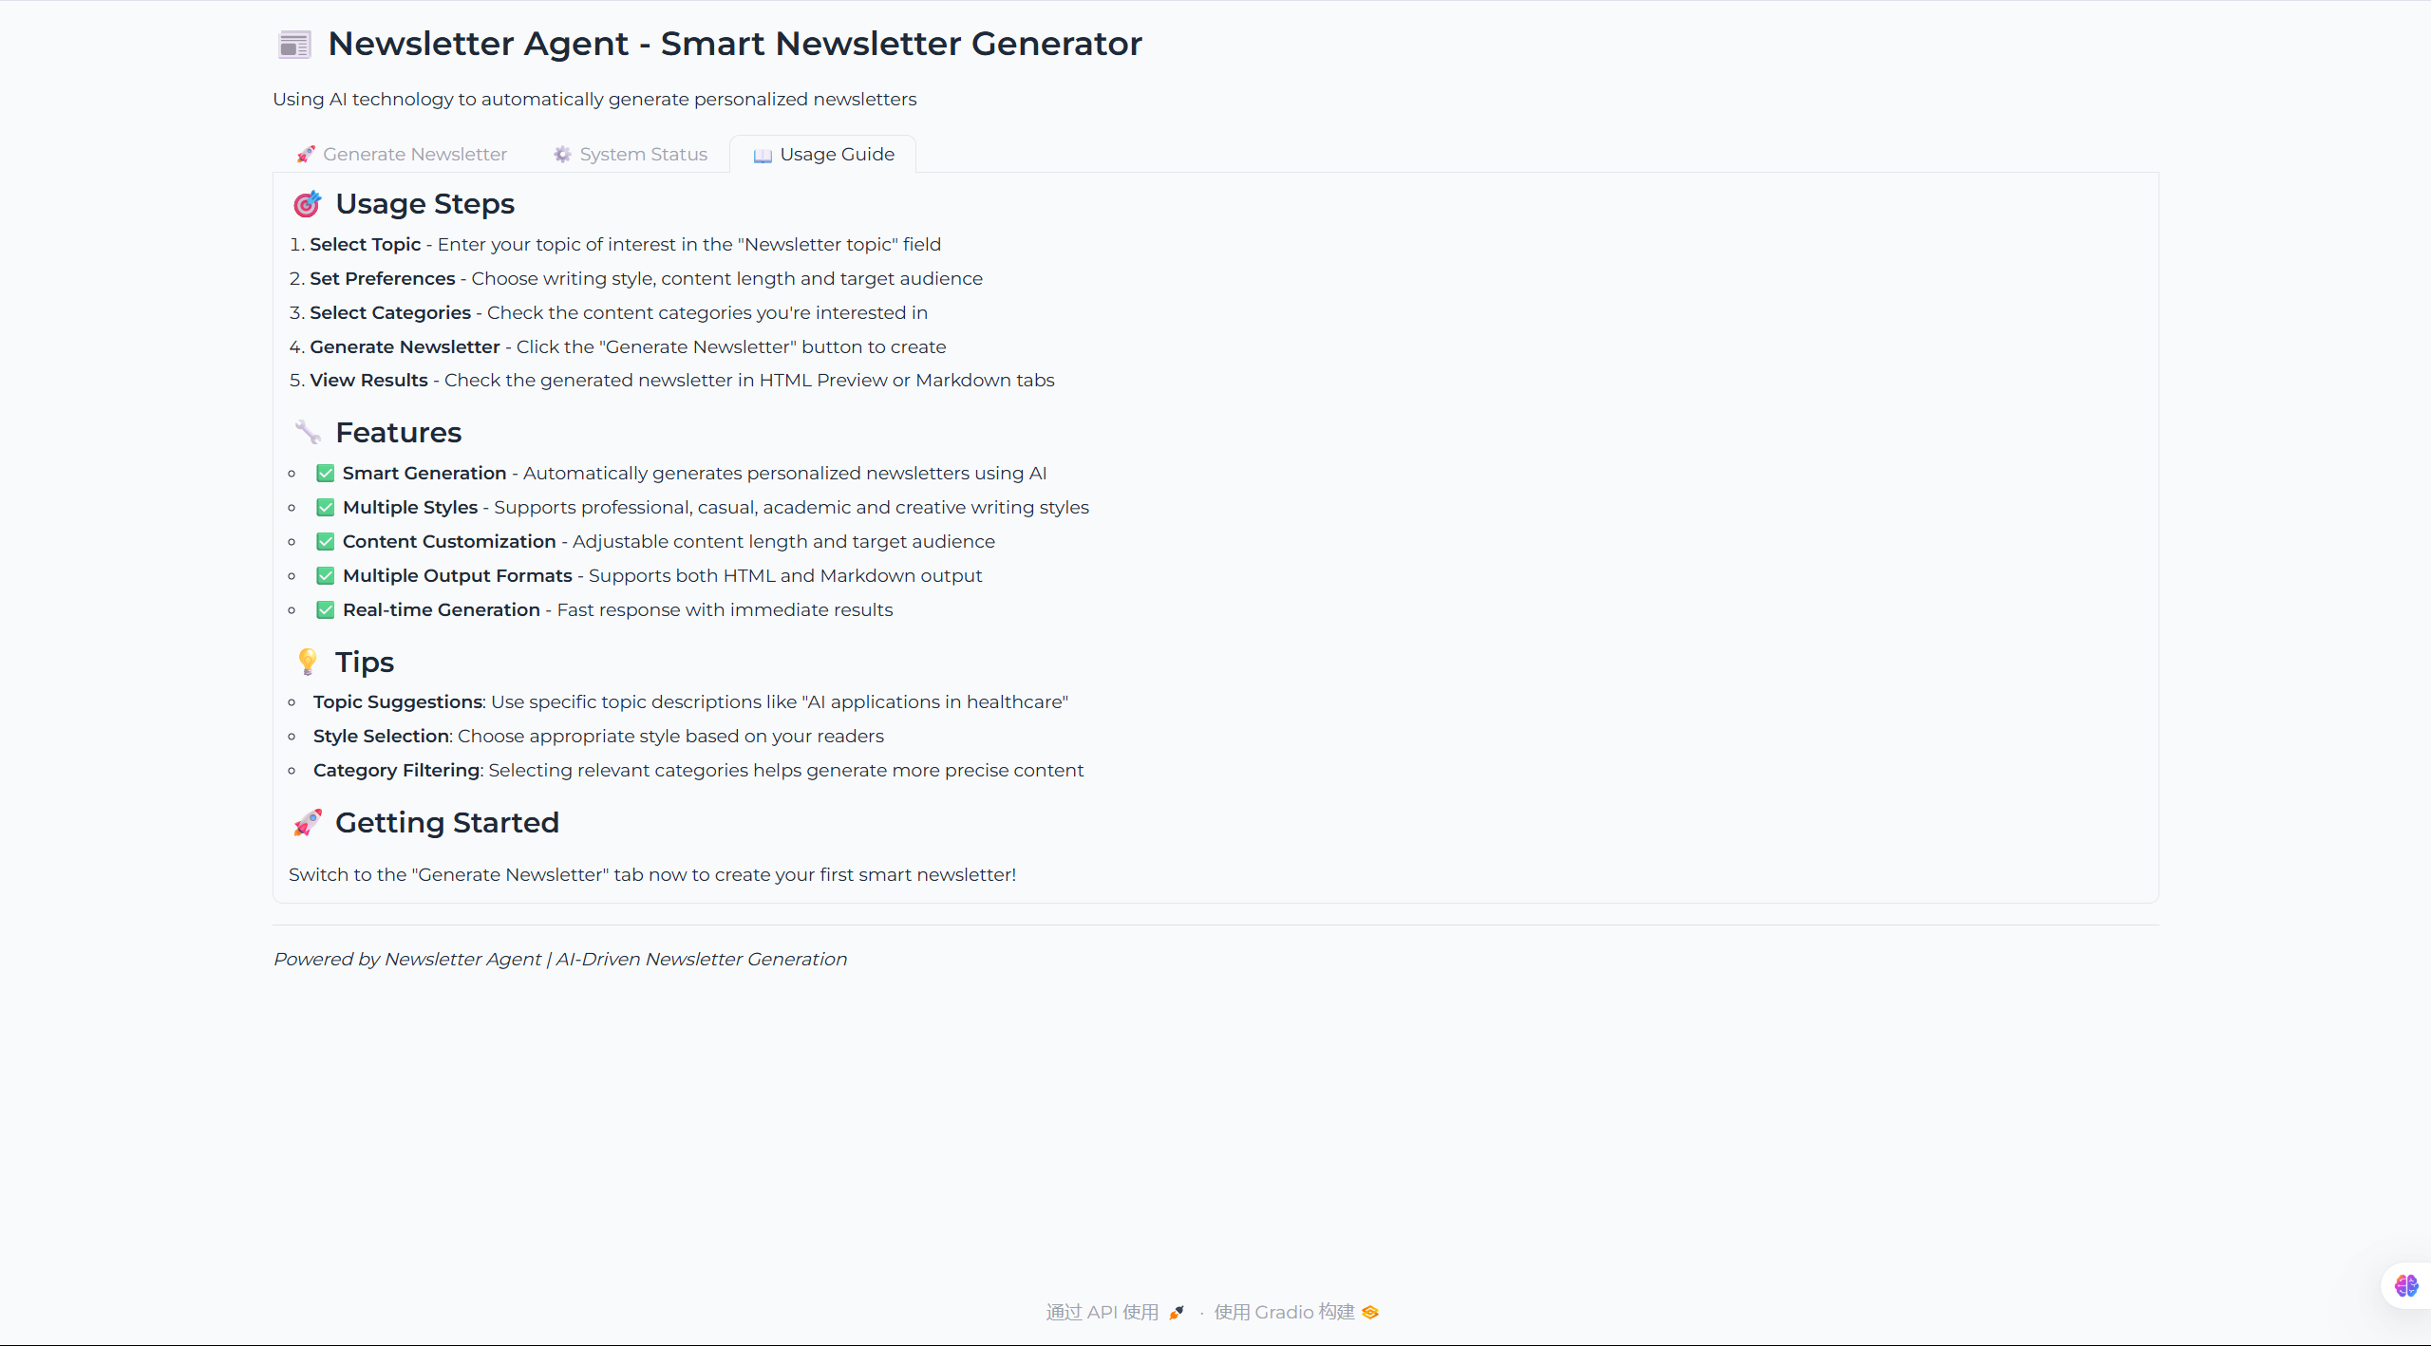
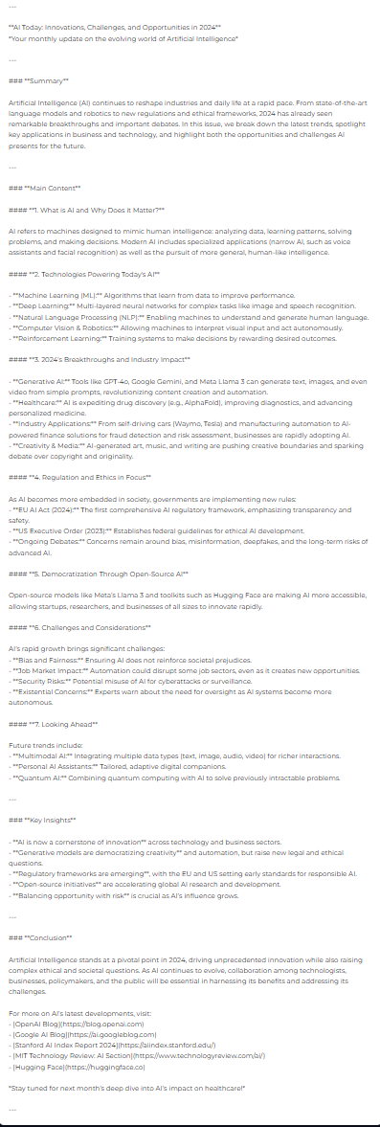
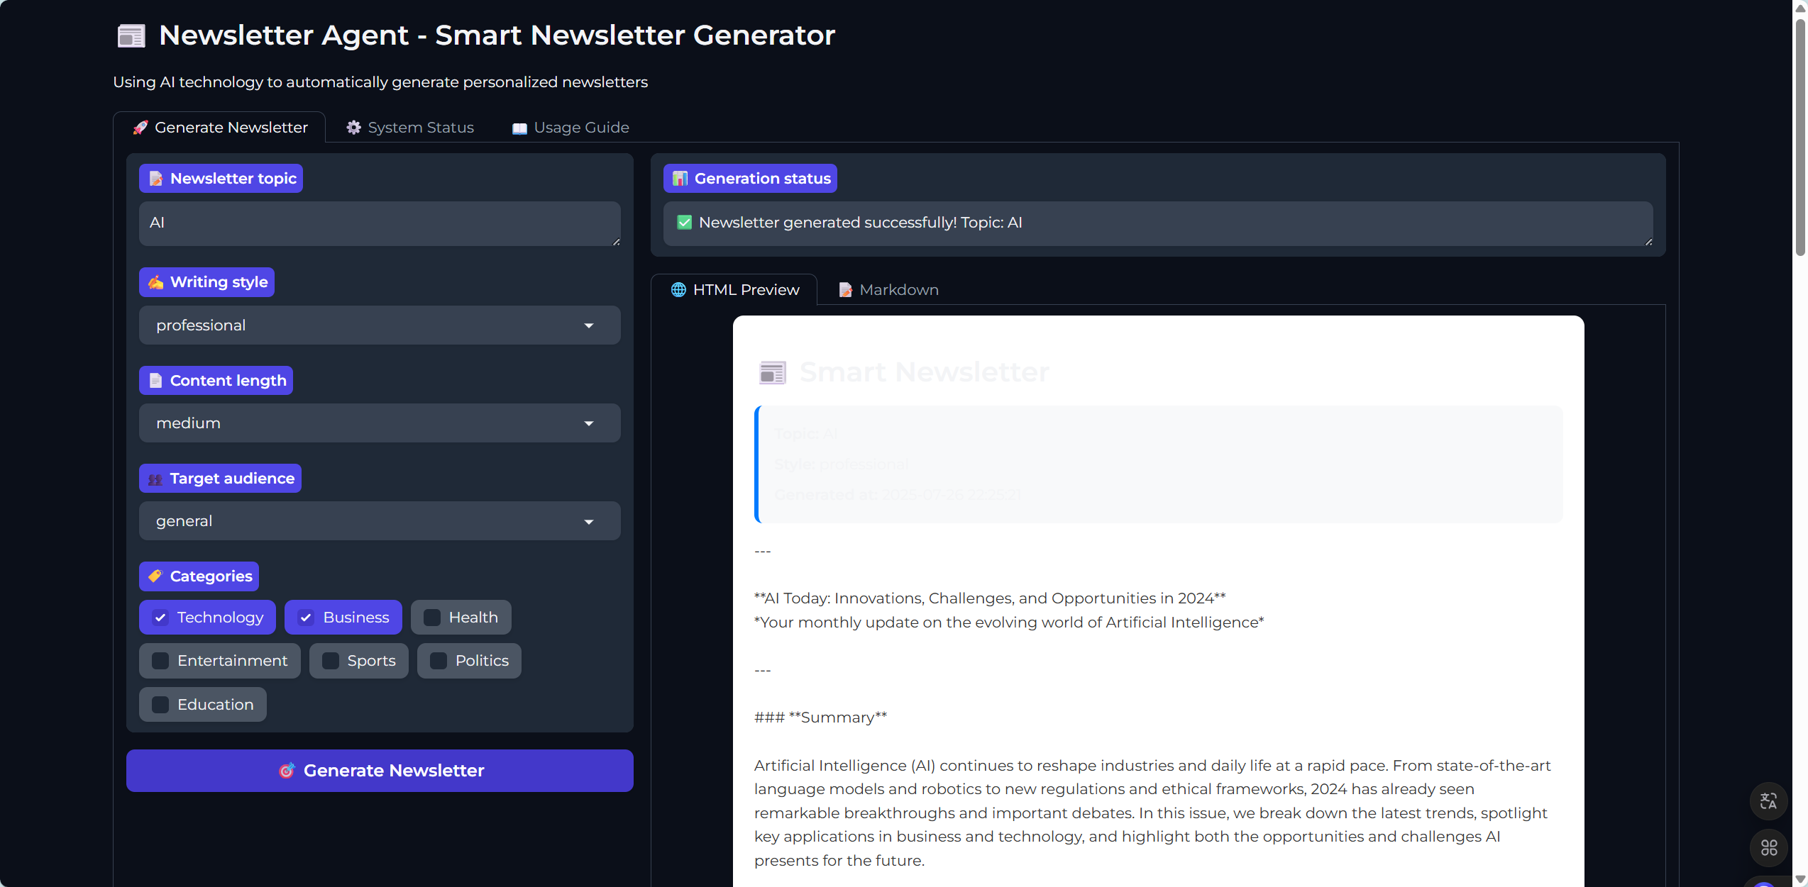
steps
Newsletter
summary
Main text
tips
Key insights
Conclusion

Slide 21
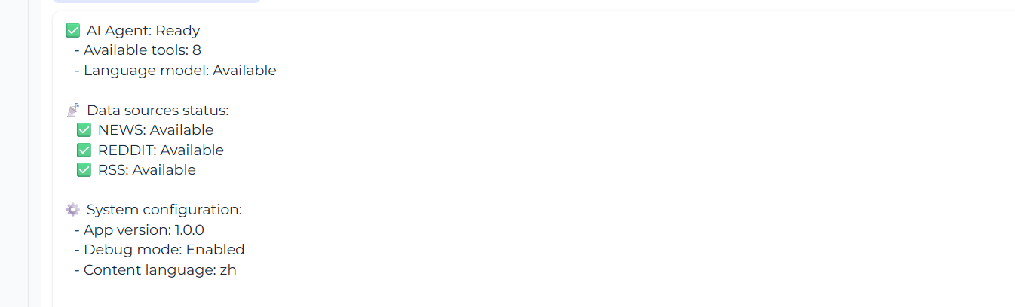
feature
Advantage：
Intelligent AI agent capabilities
Multi-step task reasoning
Dialogue History Management
Dynamic tool invocation
System Status information
Adaptive decision-making
Multi-source data integration
Multi-data source access
Dynamic tool invocation
Content classification
Adaptive decision fusion
Personalized content generation
Customized target audience
Multiple writing styles
Classification screening
Adjustable length

Slide 22
05
Technical Highlights and Innovations

Slide 23
Technical Innovations
Tool Ecosystem
Intelligent Content Processing
Multi-Step Reasoning
Built a dynamic orchestration and invocation ecosystem of over eight specialized tools, enabling efficient collaboration among tools, fully leveraging their strengths, and enhancing the efficiency and quality of news briefing generation.
Combines TF-IDF keyword extraction and machine learn-ing classification techniques to achieve intelligent news content categorization,
deduplication, and quality assessment, enhancing the accuracy and efficiency of content processing.
Modular Architecture
Based on LangChain’s multi-step reasoning technology,
it enables automatic decom-position and execution of complex tasks, overcoming the limitations of traditional single-step task processing, and providing a smarter solution for news briefing generation.
Adopts a highly decoupled modular architecture design, where components operate independently. This facilitates easy scalability and main-tenance, providing convenience for future system upgrades and optimizations.

Slide 24
Project Advantages
High Degree of Automation
Strong Personalization
High Content Quality
Good Scalability
The entire process from data collection to content gene-ration is fully automated without manual intervention, saving labor costs and improving the efficiency of news briefing generation.
Offers multi-dimensional cus-tomizable content gene-ration options to meet the personalized needs of diverse user groups, enhancing user engagement.
AI-driven quality assessment and enhancement mech-anisms ensure that the generated news briefings are of high quality and valuable, thereby improving the user reading experience.
Designed with a plug-in based tool architecture, facilitating the integration of more tools and features in the future, thereby expanding the system’s application scope and capability boundaries.

Slide 25
06
Implementation Results

Slide 26

Completed Features
AI Agent System
Data Source Integration
Successfully built a complete LangChain-driven AI agent system, enabling multi-step task reasoning and tool invocation, providing core support for news briefing generation.
Tool Integration
Completed integration of multiple data sources including NewsAPI, Reddit, and RSS feeds, ensuring rich and diverse news data sources that provide a solid foundation for content generation.
Integrated over eight specialized tools covering data collection, content processing, intelligent generation, and other functions, enabling efficient collaboration among tools and enhancing overall system performance.

Slide 27

Completed Features
1
2
3
User Interface
Dual-Format Output
Configuration Management
Developed a Gradio web user interface that offers a clean and intuitive operating experience. It supports parameter configuration, status display, result preview, and other functions to meet user needs.
Implemented output in both HTML and Markdown formats to meet users’ viewing and usage needs in different scenarios, enhancing system flexibility.
A comprehensive configuration management system that enables users to flexibly configure news briefing generation parameters according to their needs, achieving personalized customization.

Slide 28
Features to Be Improved
Email Sending Function
User Subscription Management
Scheduled Generation and Delivery
The email sending functionality has been implemented in code but is not yet integrated into the user interface. The next step is to complete the UI integration to enable one-click sending of news briefings to users’ email addresses.
A user subscription management system needs to be developed to allow users to manage their subscription information, such as topics and frequency, thereby enhancing user experience.
Add scheduled generation and delivery functionality, allowing users to set timed tasks. The system will automatically generate and send news briefings at specified times to meet users’ needs for regular information updates.

Slide 29
07
Technical Challenges and Solutions

Slide 30
Key Technical Challenges
Multi-Source Data Coordination
AI Agent Stability
Rate limits and data format differences across various APIs cause challenges in data collection and integration, impacting the efficiency and quality of news briefing generation.
The consistency of LLM responses and error-handling mechanisms.
Content Quality Control
Real-Time Performance Challenge​
Challenges in duplicate content identification and quality assessment make it difficult to ensure that the generated news briefings are accurate and valuable, which negatively impacts user experience.
Intensive data processing strains system resources. Real-time optimization difficulties directly impact briefing timeliness.

Slide 31
​Solutions
Multi-tiered Quality Control
Robust Error Handling
Implement cascading eva-luation layers coupled with content enrichment tools for deep news refinement, elevating output value.
Deploy AI-agent fallback strategies with graceful degradation, ensuring reliable bulletin generation amid exceptions.
​​Data Structure Unification
Performance Optimization
tandardize schemas across diverse sources with intelligent deduplication, resolving integration
bottlenecks and boosting processing throughput.
Apply async processing and caching mechanisms to accelerate system response, meeting real-time delivery SLAs.

Slide 32
08
Summary and Future Work

Slide 33
Project Outcomes
Full System Deployment
1
Successfully engineered an end-to-end AI-powered news briefing system, demonstrating LangChain's capabilities in complex AI applications through intelligent multi-source integration and personalized content generation pipelines.
Technical Milestones Achieved
2
Established critical infrastructure including:Autonomous AI agent frameworks, Multi-API/tool orchestration layers, Multi-step workflow execution engines, Automated content generation systems.

Slide 34

​Future Development Roadmap​
1
3
2
​​Subscription Ecosystem Evolution
AI Agent Amplification​
Data Ingestion Expansion​
Upgrade email delivery & subscription management systems for sustained bulletin delivery, ensuring long-term user engagement viability.
Implement continuous learning loops with feedback-driven optimization, enabling adaptive strategies to maintain >95% content relevance.
Diversify sources (finance/SDI/social) and content formats (video/audio),
broadening coverage scope by >40% for enhanced intel value.

Slide 35
​Strategic Roadmap
1
2
Mobile Ecosystem Integration​
Globalization Framework
Develop cross-platform native apps & adaptive PWA solutions, enabling 24/7 bulletin access with >95% device compatibility.
Deploy i18n/l10n pipelines for 20+ language coverage, expanding service footprint to EMEA/APAC markets.

Slide 36
THANK YOU
Group 8
Report Date: July 27, 2025

